Slide 1
Louisiana Senate
Finance Committee
FY23 Executive Budget
13 –Department of Environmental Quality
March 2022
Senator Patrick Page Cortez, President
Senator Bodi White, Chairman

Slide 2
FY23 Recommended Budget
Schedule 13 — Environmental Quality Agencies
Departmental mission — “The mission of the Department of Environmental Quality is to provide service to the people of Louisiana through comprehensive environmental protection in order to promote and protect health, safety and welfare while considering sound policies regarding employment and economic development.”
Secretary
Environmental Compliance
Environmental Services
Management and Finance
13-856
Office of
Environmental Quality
Environmental Assessment

Slide 3
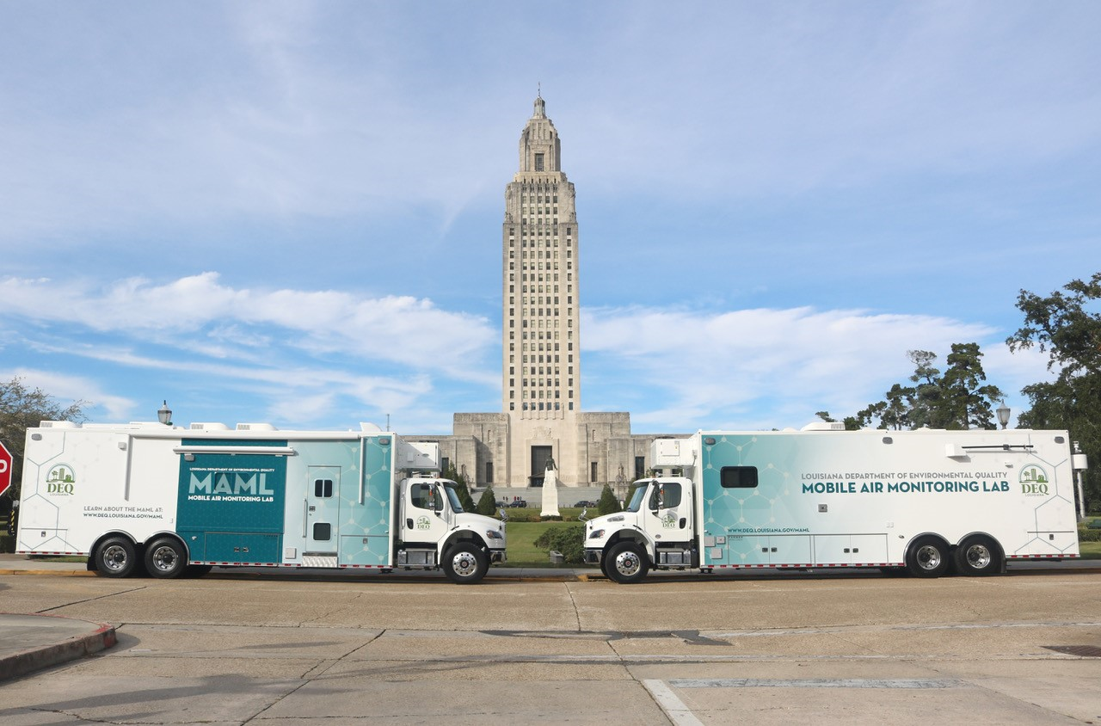
Environmental Quality
FY23 Program Descriptions by Agency
Office of the Secretary
Audit Services
Office of Environmental Compliance
Surveillance and Inspection of Facilities
Legal Affairs
Executive Administration
Business & Community Outreach
Public Information.
Criminal Investigations
Enforcement
Emergency & Radiation Services.
Office of Environmental Services
Office of Management and Finance
Office of Environmental Assessment
Air Permits
Water Permits
Waste Permits
Public Participation & Permits Support
LA Environmental Lab Accreditation
Financial Services
Human Resources
Waste Tires (OMF-Payments)
OMF Support & Department wide Costs
Technology Service and Records Management
Air Planning and Assessment
Water Planning and Assessment
Remediation
Underground Storage Tanks

Slide 4
Environmental Quality
Changes in Funding since FY15
Change from FY15 to FY23 is +38.6%.
Change from FY15 to FY21 is +19.9%.
$139.5
$144.8
$144.8
$122.4
$115.2
$104.5
$110.1
$101.5
$103.1

Slide 5
Environmental Quality
Significant Budget Adjustments Recommended for FY23
5

Slide 6
Environmental Quality
Non-Statewide Budget Adjustments Recommended for FY23
6

Slide 7
Environmental Quality
Non-Statewide Budget Adjustments Recommended for FY23
7

Slide 8
Environmental Quality
FY23 Recommended Means of Finance
Non-SGF Sources of Funding:
Non-State General Fund sources of funding for the Department of Environmental Quality are derived from Interagency Transfers, Fees and Self-generated Revenues, Statutory Dedications, and Federal Funds.
The Interagency Transfers are from CPRA for BP Natural Resource Damage Assessment (NRDA) work. DEQ bills CPRA quarterly for these charges.
Fees and Self-generated Revenues are derived from the sale of regulations, manifest forms, and photocopies. The Statutorily Dedicated Environmental Trust Fund was re-classified as Fees and Self-generated Revenues in accordance with Act 404 of the 2019 Regular Session. The Lead Hazard Reduction Fund, the Motor Fuels Underground Tank Fund, and the Waste Tire Management Fund were re-classified as Fees and Self-generated Revenues in accordance with Act 114 of the 2021 Regular Legislative Session.
Statutory Dedications, which make up twenty-nine percent of DEQ’s total means of finance, are derived from the Oil Spill Contingency Fund, Hazardous Waste Site Cleanup Fund and the Clean Water State Revolving Fund.
Federal Funds are derived from grants issued by the Environmental Protection Agency, U.S. Department of Energy, and the U.S. Department of Defense.

Slide 9
Environmental Quality Dedicated Funds
FY21, FY22, and FY23 Recommended
The Lead Hazard Reduction Fund, the Motor Fuels Underground Tank Fund, and the Waste Tire Management Fund were re-classified as Fees and Self-generated Revenues in accordance with Act 114 of the 2021 Regular Legislative Session.

Slide 10
Environmental Quality
FY22 Enacted vs. FY23 Recommended Means of Finance by Agency
The FY23 Recommended Budget for DEQ is an increase of $5.2 million over FY22 Enacted. This equates to a 3.8 percentage increase.
The Office of Environmental Assessment showed the largest increase of $2.9 million followed by the Office of Environmental Compliance at $2.3 million. The Office of Management and Finance showed a decrease of ($1.5 million).
Fees and Self-generated Revenues showed the greatest increase at $31.7 million. There was a reduction in Statutory Dedications of ($28.8 million). This reduction is due to the Lead Hazard Reduction Fund, Motor Fuels Underground Tank Fund, and the Waste Tire Management Fund being re-classified as Fees and Self-generated Revenues in accordance with Act 114 of the 2021 Regular Legislative Session.
10

Slide 11
Categorical Expenditures
Examples of Categories
Departments expend funding in the five major categories listed below.
Personal Services
Salaries – Regular, overtime, and termination pay for Classified and Unclassified personnel.
Other Compensation – Wages, student labor, compensation for board members and/or board of trustees, evening instruction, university instructors, etc.
Related Benefits – Retirement contributions, post-retirement contributions/benefits, FICA tax, Medicare tax, group insurance contributions, compensated absences, other related benefits, taxable fringe benefits, etc.
Total Operating Expenses
Travel – In-state and Out-of-state, including meal reimbursement.
Operating Services – Advertising, printing, insurance, maintenance, rentals, data processing, internet costs, dues and subscriptions, mail delivery, telephones, data lines, vehicle tracking and telematics, utilities, depreciation, amortization, banking services, credit card fees, etc.
Supplies – office supplies and equipment, computers, clothing and uniforms, medical, pharmaceutical, food, automotive, repair and maintenance, software, etc.
Professional Services – Accounting, auditing, management consulting, engineering, architectural, legal, medical and dental, veterinary, information technology, etc.
Total Other Charges
Other Charges – Aid to school boards, local government, etc.; public assistance; miscellaneous charges; judgments, fines, and penalties; interest on judgments; punitive/compensatory damages; OC personal services, operating expenses, professional services; contract attorney expenses; recoupments; furlough; contractual services; interest expense; claim payments; commercial group insurance; reinsurance; loans issued; disbursements; etc.
Debt Service – Principal, interest, related charges, reserve requirement, amortization, and bond premiums.
Interagency Transfer Line-Item Expenditure – Any expenses paid for with Interagency Transfers – from commodities and services to equipment.
Acquisitions and Major Repairs
Acquisitions – Land; buildings; automobiles; aircraft; accessories; equipment; software; hardware; farm and heavy equipment; boats; capital outlay expenditures; construction; etc.
Major Repairs – Land improvement; buildings; automotive; grounds; boats; aircraft; movable equipment; farm equipment; medical; office; library; education; recreation; communication; other equipment; pollution remediation; etc.
Source: OPB Expenditure Budget Adjustment Form

Slide 12
DEQ Categorical Expenditures
FY21, FY22, and FY23
For FY23 Recommended,
the largest Expenditure Category is Personal Services, which makes up 54 percent of Total Expenditures.
The Other Charges category, which makes up over 37 percent of Total Expenditures, includes
funding for Motor Fuels Underground Storage Tank to reimburse Response Action Contractors of eligible tanks for cleanup of leaking underground storage
tanks; Legal services; Waste Tire program for payments to permitted processors for proper disposal of collected waste tires; To provide services for investigation, testing, containment, control and cleanup of hazardous waste sites.
FY21 Total
$125.3 m.
FY22 Total
$144.8 m.
FY23 Total
$144.8 m.
Personal Services
Operating Expenses
Professional Services
Other Charges
Acquisitions and Major Repairs

Slide 13
Environmental Quality
FTEs, Authorized T.O., and Other Charges Positions
The full-time equivalent or FTE definition refers to the number of hours considered full-time. For example, if an agency considers 40 hours full time, and there are two employees working 20 hours per week, those two employees would be 1.0 FTE.
Authorized Positions are those referred to in the Table of Organization (or T.O.) for each department. This count includes only those positions paid for from the Salaries expenditure category for the organization units and agencies include in each department’s appropriation. This excludes positions paid for from other expenditure categories, such as wages or per diem.
Other Charges positions are authorized under R.S. 39:2(5)(b) …
(5)(b) "Authorized other charges positions" means the number of positions in an appropriation bill to be funded by the other charges continuing category of the accounting system for the state. The number may be adjusted during a fiscal year in accordance with law.
[Act 377 of 2013 by Rep. Burrell]
Positions coded in the Other Charges expenditure category
These positions are usually associated with federal grants
FY22 number of funded, but not filled, positions as of January 31= 35
13

Slide 14
Environmental Quality
Related Employment Information
Salaries and Related Benefits for the 707 Authorized Positions are listed below in Chart 1.
In Chart 2, benefits are broken out to show the portion paid for active versus retired employees.
This is where payments for the Unfunded Accrued Liability (UAL) can be found.
1.
Personal Services | 2020 Actual | 2021 Actual | 2022 Enacted | 2023 Recommended
Salaries | $43,448,730 | $44,603,059 | $46,379,998 | $49,219,493
Other Compensation | $787,498 | $382,517 | $211,043 | $211,043
Related Benefits | $24,853,318 | $25,214,258 | $26,417,377 | $28,178,128
Total Personal Services | $60,089,546 | $70,199,834 | $73,008,418 | $77,608,664
Average T.O. Salary = $66,533
Examples of Other Compensation include pay for WAE employees, part-time employees, student workers, etc.
Department Demographics | Total | %
Gender
Female | 400 | 56.7
Male | 306 | 43.3
Race/Ethnicity
White | 543 | 76.9
Black | 117 | 16.6
Other | 46 | 6.5
Currently in DROP or Eligible to Retire | 159 | 23
2.
Related Benefits FY23 Recommended | Total Funding | %
Total Related Benefits | $28,178,128
UAL payments | $12,487,267 | 44%
Retiree Health Benefits | $3,704,354
Remaining Benefits* | $8,006,562
Means of Finance | General Fund = 1% | Other = 99%
* Remaining Benefits include employer contribution to authorized positions’ retirement, health, Medicare, FICA, Emoluments etc. The authorized positions include authorized T.O. positions and authorized other charges positions, both filled and vacant.
Other Charges Benefits
$0
14

Slide 15
Environmental Quality
FY23 Recommended Total Authorized Positions by Agency

Slide 16
Environmental Quality
FY23 Discretionary/Non-Discretionary Comparison
FY23 Recommended
Discretionary — $98,088,896
Discretionary SGF = $4,458,615
Discretionary IAT = $4,460,415
Discretionary FSGR = $77,015,639
Discretionary DEDS = $8,602,619
Discretionary FED = $3,551,608
Discretionary
T.O. = 707
Non-Discretionary SGF = $110,215
Non-Discretionary IAT = $39,004
Non-Discretionary FSGR = $29,788,425
FY23 Recommended
Non-Discretionary — $46,667,189
Non-Discretionary DEDS = $1,046,852
Non-Discretionary FED = $15,682,693
Non-Discretionary T.O. = 0
16

Slide 17
13 – Environmental Quality
Enacted & FYE Budget vs. Actual Expenditures FY18 to FY21
FYE Budget = “Fiscal Year End” Budget includes all in-house and regular BA-7s through June 30 of the fiscal year. For FY22, it is as of January.
FY22 Known Supplemental Needs:
$
$124.9 m. = FY22 Adjusted Budget x 86.3%
FY21 General Fund Reversions:
$0
17

Slide 18
Department of Environmental Quality
Waste Tire Fee Collection History – FY01 to FY22
Note: Act 846 of the 2004 RLS changed the tires to which the fee was applicable and greatly increased annual tire fee revenues, as shown. See LRS 30:2418.
Note: As of 3/31/19 FY19 collections total $8.7 million.
Source: Department of Environmental Quality.

